Slide 1
Synchronous Counter
RP

Slide 2
Definition
A synchronous counter , in contrast to an asynchronous counter , is one whose output bits change state simultaneously, with no ripple.

Slide 3
The only way we can build such a counter circuit from J-K flip-flops is to connect all the clock inputs together, so that each and every flip-flop receives the exact same clock pulse at the exact same time

Slide 4
􀁺 Now, the question is, what do we do with the J and K inputs? We know that we still have to maintain the same divide-by-two frequency pattern in order to count in a binary sequence, and that this pattern is best achieved utilizing the "toggle" mode of the flip-flop, so the fact that the J and K inputs must both be (at times) "high" is clear. However, if we simply connect all the J and K inputs to the positive rail of the power supply as we did in the asynchronous circuit, this would clearly not work because all the flip-flops would toggle at the same time: with each and every clock pulse!

Slide 5
How To Design Synchronous Counter

Slide 6
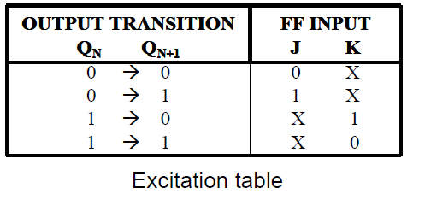
Design a MOD-4 synchronous up-counter, using JK FF.
STEP 1: No of FF=2
STEP 2: Excitation Table

Slide 7
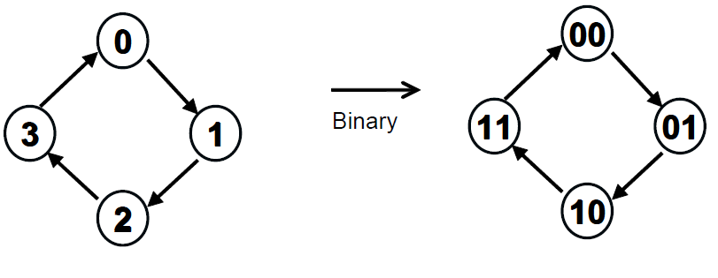
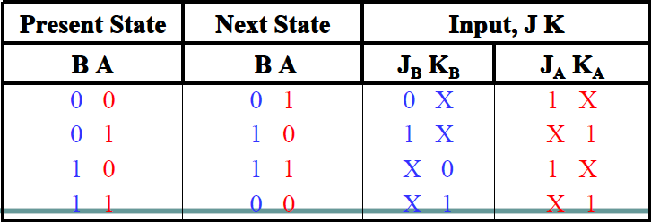
Design a MOD-4 synchronous up-counter, using JK FF.
Step 3:

Slide 8
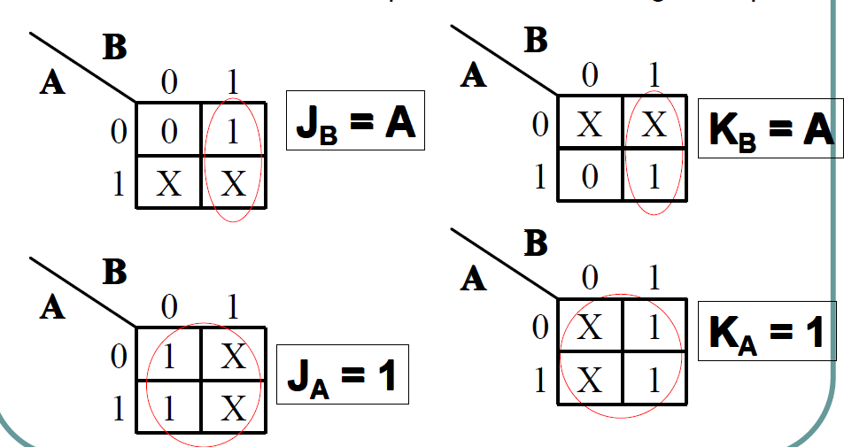
Step 4: Obtain the simplified function using K-Map
A
A
B
B
A
A
B
B

Slide 9
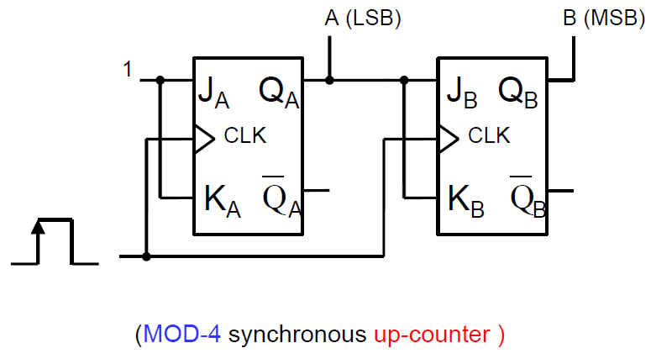
Step 5: Draw the circuit diagram.

Slide 10
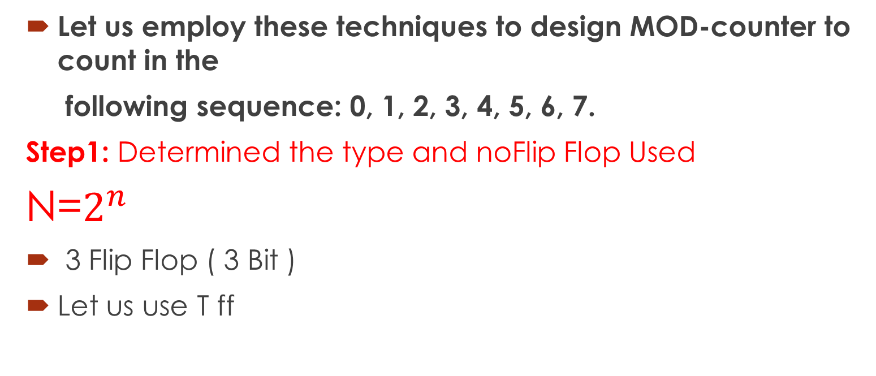
Design a MOD-8 synchronous up-counter, using JK FF.
Let us employ these techniques to design MOD-counter to count in the
following sequence: 0, 1, 2, 3, 4, 5, 6, 7.
Step1: Determined the type and noFlip Flop Used
N=$2^{n}$
3 Flip Flop ( 3 Bit )
Let us use T ff

Slide 11
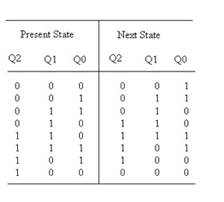
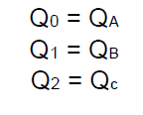
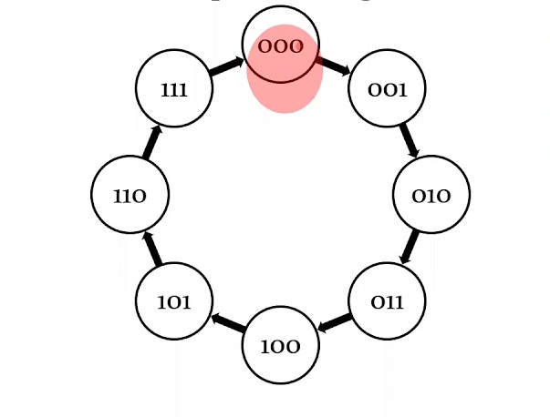
Step2: State transition diagram & State Table

Slide 12
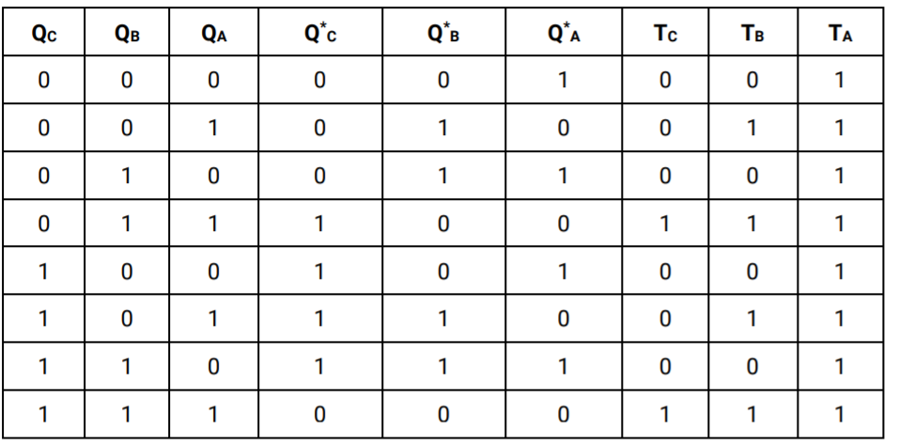
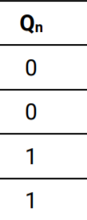


Step 3: Expand the present state-next state table to form the transition table.
Excitation Table

Slide 13
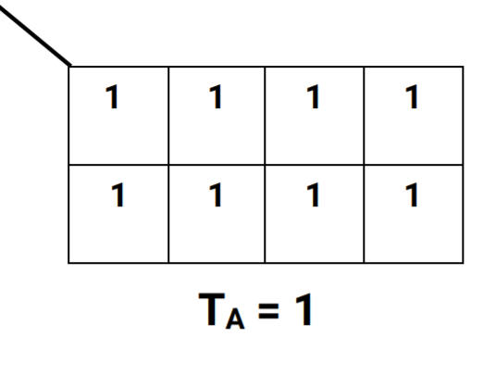
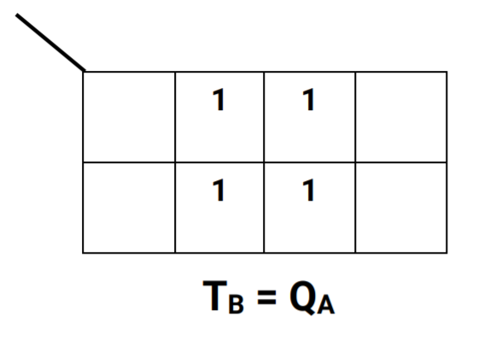
Step 4: Use Karnaugh maps to identify the present state logic functions for each of the inputs.
QB QA
QB QA
QC
QC

Slide 14
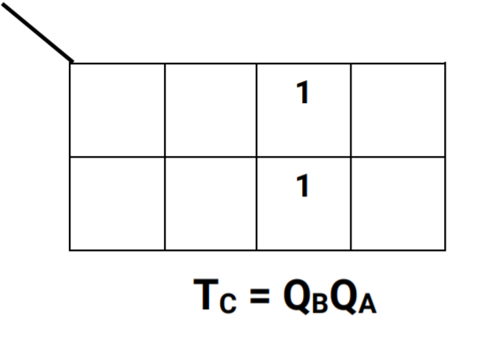
QB QA
QC

Slide 15
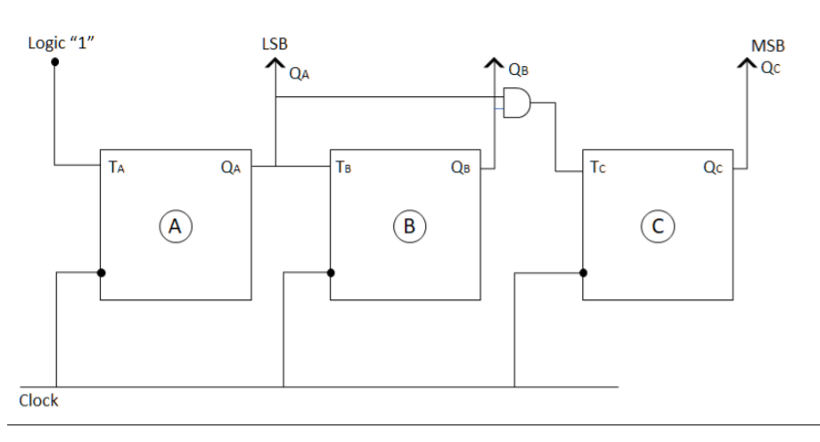
Circuit Implementation

Slide 16
How To Design Synchronous Counter that count Random number
Design a Synchronous Counter to Count 4,7,3,0 and 2 respectively using JKFlip Flop negative trigered by showing:
i. Flip Flop Used
ii. State Transition Diagram
iii. Exitation Table / Present state, next State
iv. Karnough Map & perform Simplified Function
v. The Synchronous Counter

Slide 17
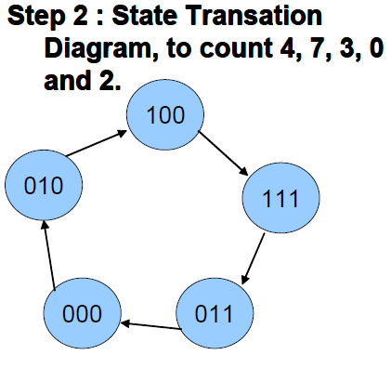
n = 3 bit = 3 Flip Flop

Slide 18
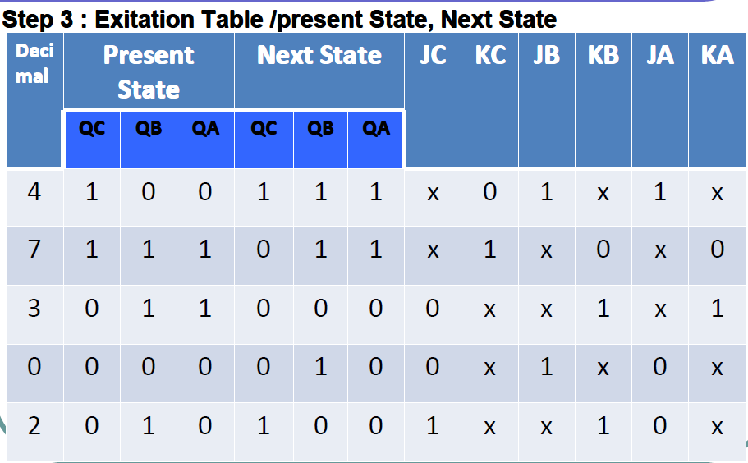
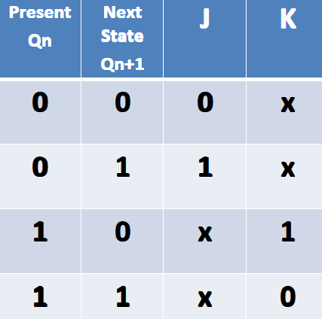
Synchronous Counter to Count 4,7,3,0 and 2 respectively

Slide 19
Step 4: Karnough Map and Simplified Function K Map for JA
C B A
BA
4=100
5=101
7=111
6=110
C
0 0 | 1X | 3 X | 2 0
4 1 | 5X | 7 X | 6 X
JA= C=QC

Slide 20
Step 4: Karnough Map and Simplified Function K Map for KA
C B A
BA
0=000
1=001
3=011
2=010
C
0 X | 1X | 3 1 | 2 X
4 X | 5X | 7 0 | 6 X
KA= C=QC

Slide 21
Step 4: Karnough Map and Simplified Function K Map for JB
BA
JB=1
C
0 1 | 1X | 3 X | 2 X
4 1 | 5X | 7 X | 6 X

Slide 22
Step 4: Karnough Map and Simplified Function K Map for KB
C B A
BA
0=000
1=001
3=011
2=010
C
0 X | 1X | 3 1 | 2 1
4 X | 5X | 7 0 | 6 X
KB= C=QC

Slide 23
Step 4: Karnough Map and Simplified Function K Map for Jc
C B A
BA
2=010
6=110
C
0 0 | 1X | 3 0 | 2 1
4 X | 5X | 7 X | 6 X
Jc= BA=QBQA

Slide 24
Step 4: Karnough Map and Simplified Function K Map for Kc
C B A
BA
2=010
3=011
7=111
6=110
C
0 X | 1X | 3 X | 2 X
4 0 | 5X | 7 1 | 6 X
Kc= B=QB

Slide 25
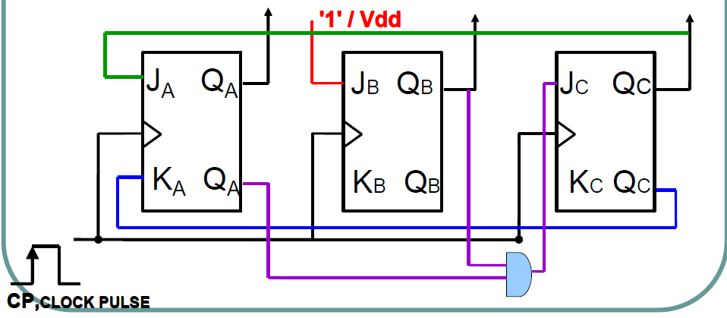
Circuit Implementation
A
B
C

Slide 26


